Slide 1
Git Branching
Working with features

Slide 2
What are branches?
A repository has a default branch master
All commits recorded on this branch
New branches allow us to work on tasks in a separate workspace
These are called feature branches
Feature branches can be discarded
Feature branches can be merged back into master

Slide 3



Creating a branch
The git command git branch shows all branches
Create a new branch with git branch <branchname>

Slide 4
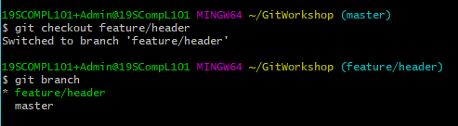
Switch to branch
Git command git checkout <branchname>
Commits made on feature/header are independent

Slide 5
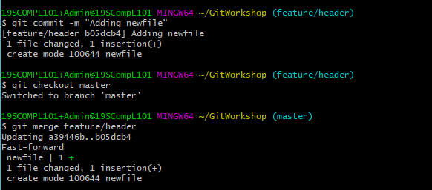
Merging branches
Use command git merge <branchname>

Slide 6
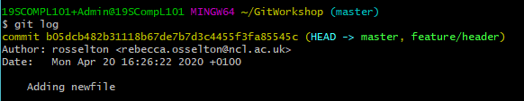

Git log
Use command git log to view changes
Feature/header can be deleted: git branch -d <branchname>

Slide 7
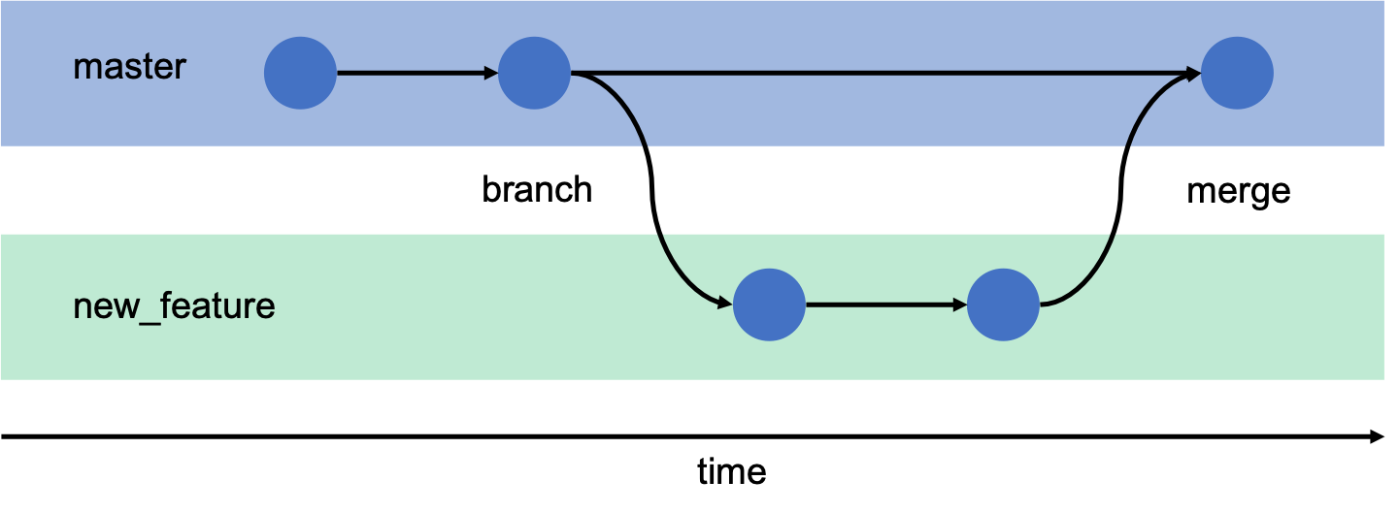
Branches overview

